Slide 1
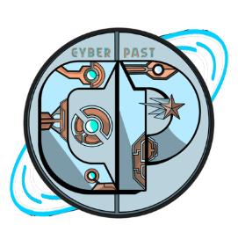

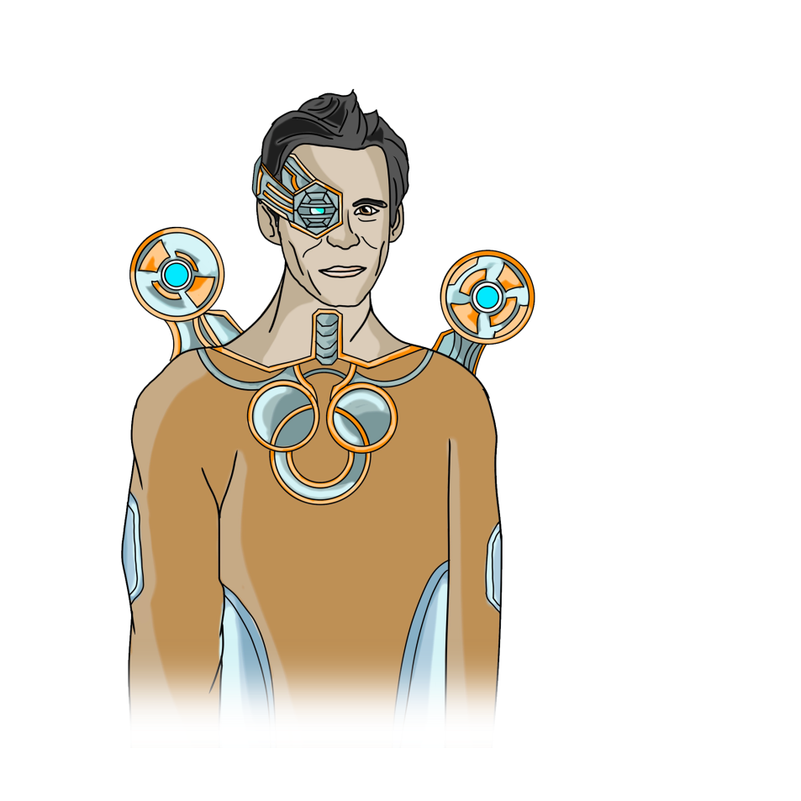
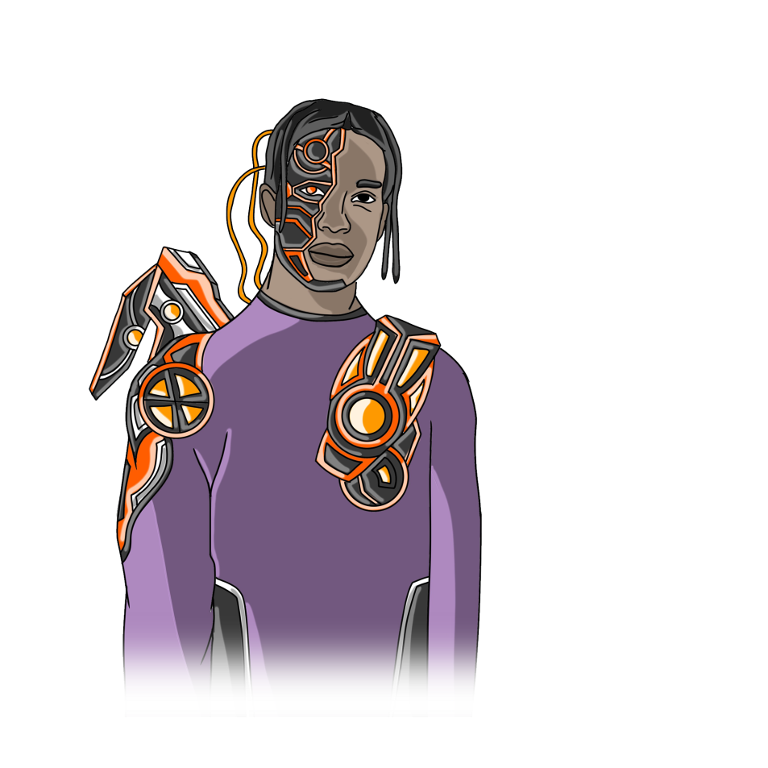
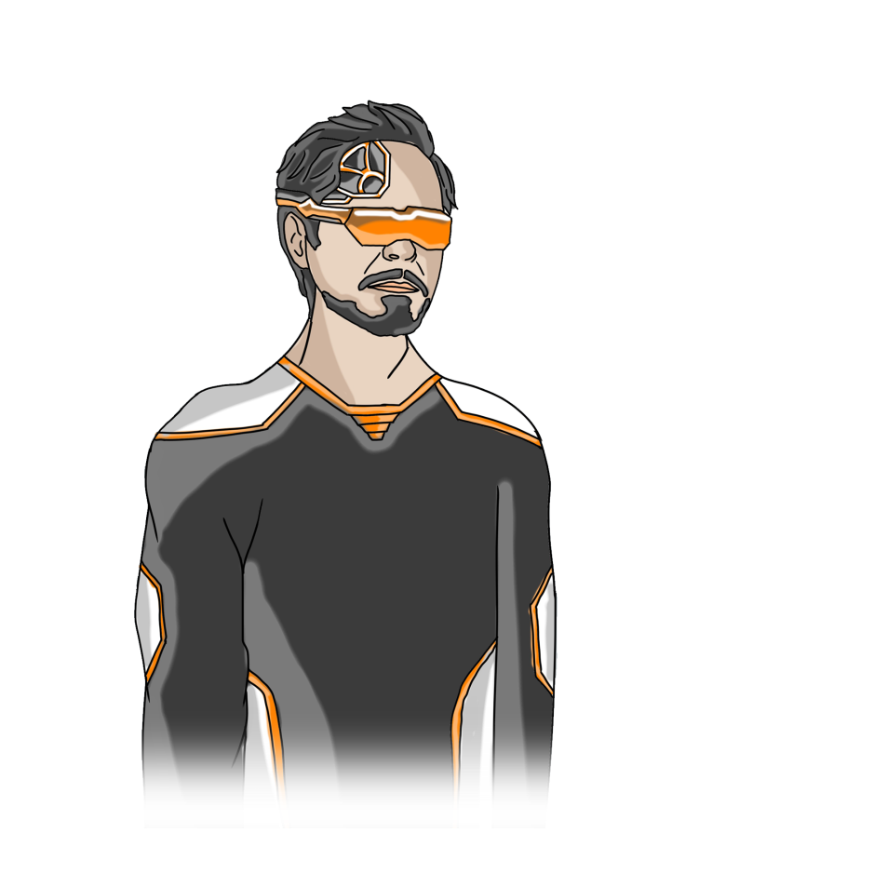

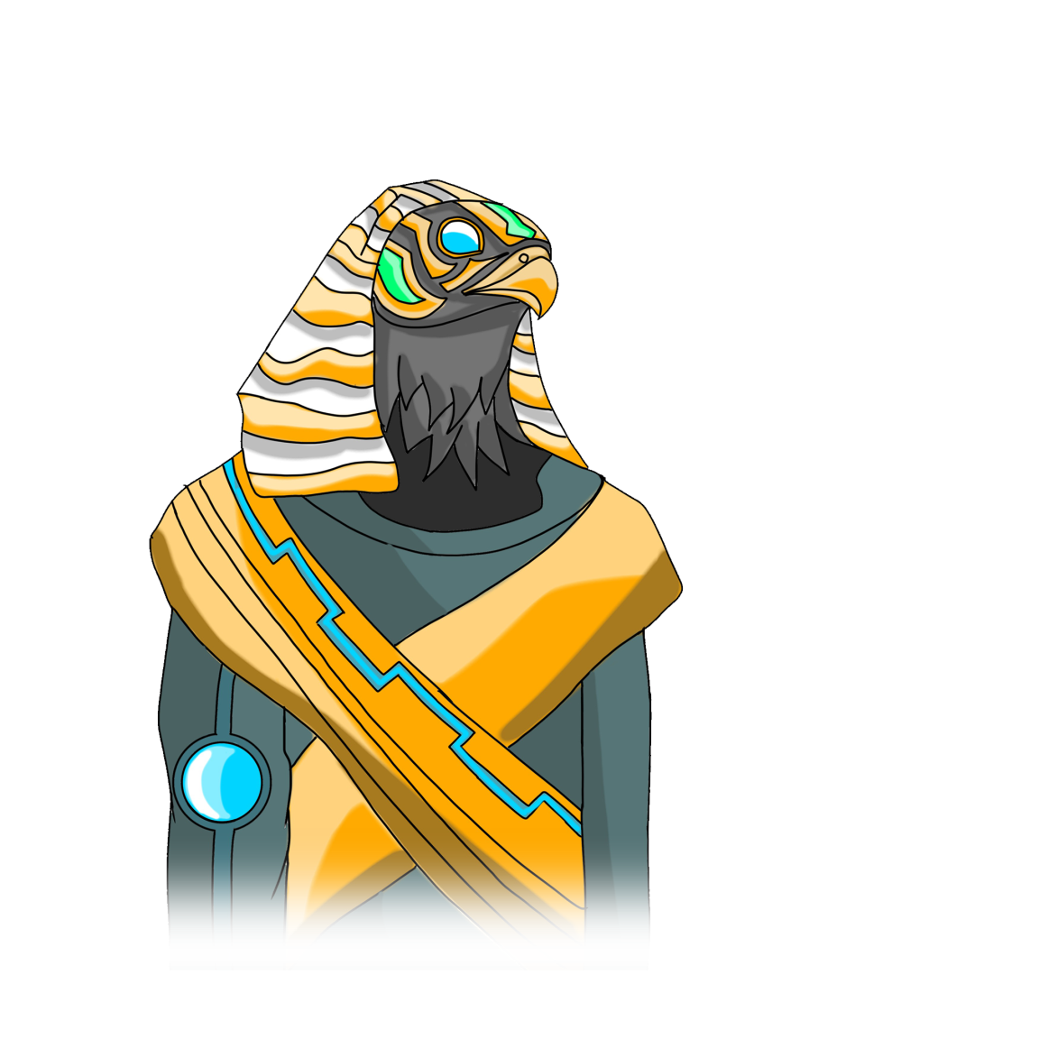
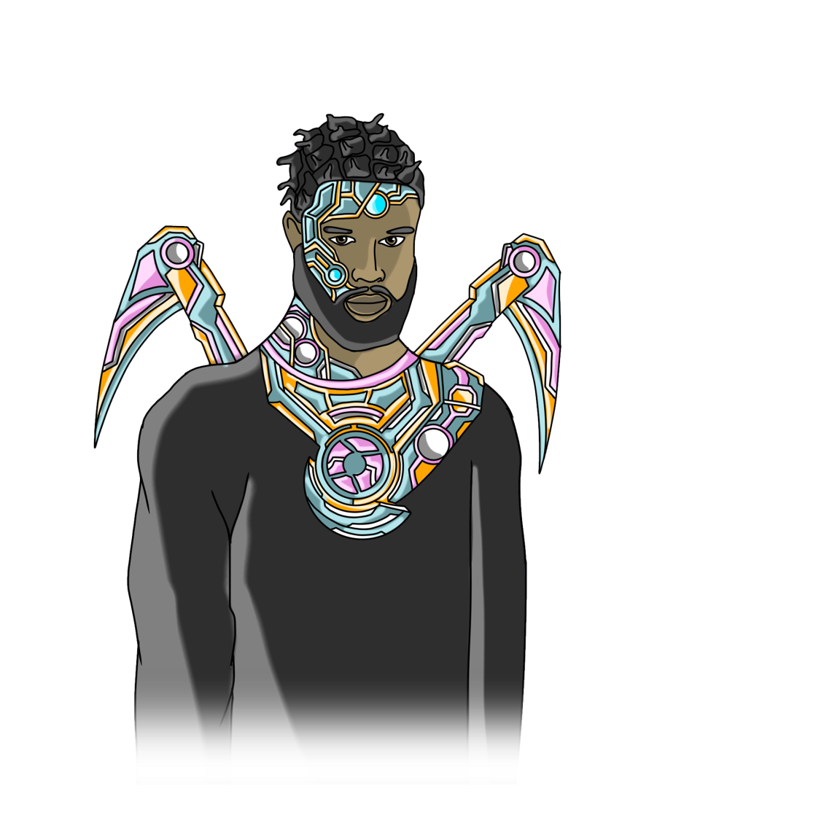
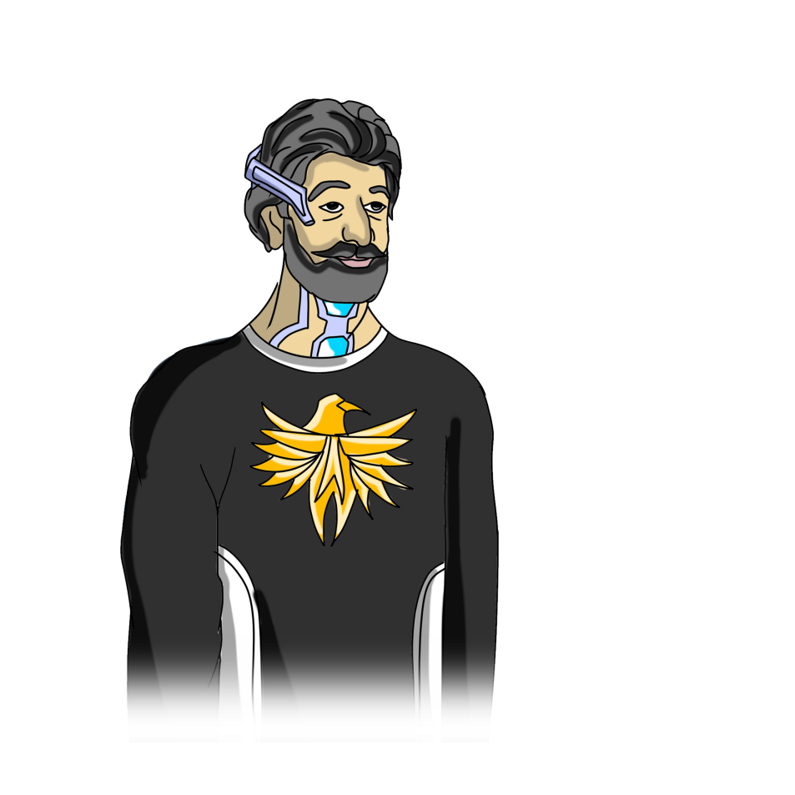
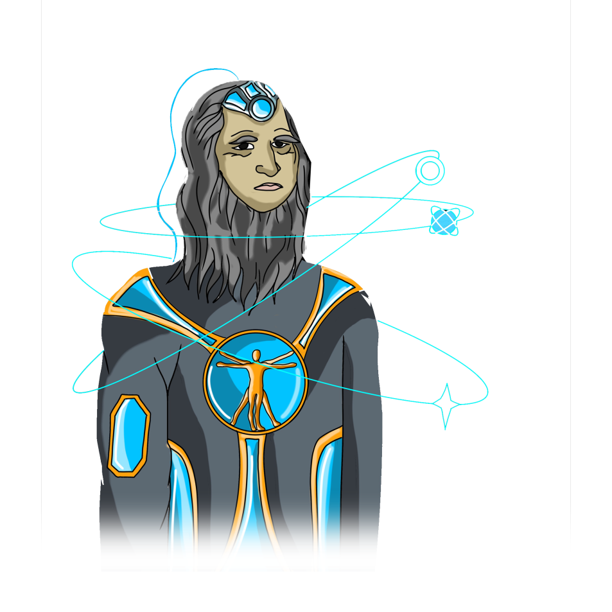
Q1 (2024)
Community Creation
Define the vision, mission, and goals of CyberPast. Identify the target audience, the value proposition, and the competitive advantage of the NFTs. Conduct market research and analysis to validate the idea and the demand. Choose a suitable blockchain platform and NFT standard for the project. Create a project name, logo, and website.

Slide 2
Q2 (2024)
Community Creation
Develop the initial concept and design of the NFTs. Decide on the number, rarity, and attributes of the NFTs. Hire or collaborate with artists, developers, and other professionals to create the NFTs. Test the NFTs for functionality and quality. Set up a smart contract and a minting process for the NFTs.

Slide 3
Q3 (2024)
Community Creation
Launch the first batch of 500 NFTs. Announce the date, time, and price of the minting event. Provide clear instructions and support for the users to mint the NFTs. Monitor the minting process and resolve any issues. Celebrate the success of the launch and thank the community for their support.

Slide 4
Q4 (2024)
Community Creation
Deliver the promised benefits and rewards to the NFT holders. This can include access to exclusive content, events, or services, or participation in governance or profit sharing. Provide updates and reports on the project progress and performance. Maintain communication and interaction with the community. Solicit feedback and testimonials from the NFT holders.

Slide 5
Q5 (2024)
Community Creation
Plan and execute the next phase of the project development. This can include adding new features, functionalities, or integrations to the NFTs, creating new NFT collections or collaborations, or expanding the project scope or scale. Announce the new plans and goals to the community and invite them to join the journey.

Slide 6
Q6 (2024)
Community Creation
Launch the second batch of 1,500 NFTs. Announce the date, time, and price of the minting event. Provide clear instructions and support for the users to mint the NFTs. Monitor the minting process and resolve any issues. Celebrate the success of the launch and thank the community for their support.

Slide 7
Q7 (2024)
Community Creation
Develop and launch the marketplace for NFTs. Provide a platform for the users to buy, sell, trade, or bid on the NFTs. Ensure the security, transparency, and efficiency of the transactions. Provide a user-friendly interface and a rating system for the sellers and buyers. Generate revenue from the fees or commissions of the transactions.

Slide 8
Q8 (2024)
Community Creation
Market and grow the project and the marketplace. Explore new channels, platforms, or partnerships to reach new audiences and markets. Participate in events, exhibitions, or competitions to showcase the project and the NFTs. Create and distribute press releases, articles, podcasts, or videos to increase the project visibility and credibility.

Slide 9
Q9 (2024)
Community Creation
Evaluate the project impact and value. Conduct surveys, interviews, or analytics to measure the user satisfaction, engagement, and retention. Assess the project revenue, expenses, and profitability. Identify the strengths, weaknesses, opportunities, and threats of the project. Gather feedback and suggestions from the community and stakeholders.

Slide 10
Q10 (2024)
Community Creation
Implement the necessary improvements and changes to the project and the marketplace. This can include fixing bugs, errors, or vulnerabilities, enhancing the user experience or interface, or optimizing the performance or security of the NFTs and the transactions. Communicate the changes and the reasons behind them to the community and stakeholders. Provide support and guidance for the users to adapt to the changes.

Slide 11
Q11 (2024)
Community Creation
Sell advertising space on the platform. Provide a way for the advertisers to reach the target audience and promote their products or services. Ensure the relevance, quality, and compliance of the ads. Generate revenue from the fees or commissions of the ads. Provide feedback and reports to the advertisers and the users.

Slide 12
Q12 (2024)
Community Creation
Provide educational resources to help the customers understand the technology and the potential of NFTs. Create and share blogs, newsletters, webinars, or courses to educate the customers about the basics, benefits, and best practices of NFTs. Answer the common questions and doubts of the customers. Build trust and loyalty with the customers.

